Slide 1

Mergers & Acquisitions
(and Divestitures)
SIM/NYU
The Job of the CFO
Prof. Ian Giddy
New York University

Slide 2
Mergers and Acquisitions
Mergers & Acquisitions
Divestitures
Valuation
Concept: Is a division or firm worth more within the company, or outside it?

Slide 3
The Market for Corporate Control
When you buy shares, you get dividends; and potential control rights
There is a market for corporate control—that is, control over the extent to which a business is run in the right way by the right people.
This market is constrained by
  Government
  Management
  Some shareholders
Example:
Allied Signal’s attempts
to acquire AMP, which is
located in Pennsylvania

Slide 4
The Market for Corporate Control
M&A&D situations often arise from conflicts:
Owner vs manager ("agency problems"
Build vs buy ("internalization")
Agency problems arise when owners' interests and managers' interests diverge. Resolving agency problems requires
  Monitoring & intervention, or
  Setting incentives, or
  Constraining, as in bond covenants
Resolving principal-agent conflicts is costly
Hence market price may differ from potential value of a corporation

Slide 5
“Internalization”: Is an activity best done within the company, or outside it?
Issue: why are certain economic activities conducted within firms rather than between firms?
As a rule, it is more costly to build than to buy—markets make better decisions than bureaucrats
Hence there must be some good reason, some synergy, that makes an activity better if done within a firm
Eg: the production of proprietary information
Often, these synergies are illusory

Slide 6
Takeovers as a Solution to “Agency Problems”
There is a conflict of interest between shareholders and managers of a target company—Eg poison pill defenses
Individual owners do not have suffcient incentive to monitor managers
Corporate takeover specialists, Eg KKR, monitor the firm's environment and keep themselves aware of the potential value of the firm under efficient management
The threat of a takeover helps to keep managers on their toes—often precipitates restructuring.

Slide 7
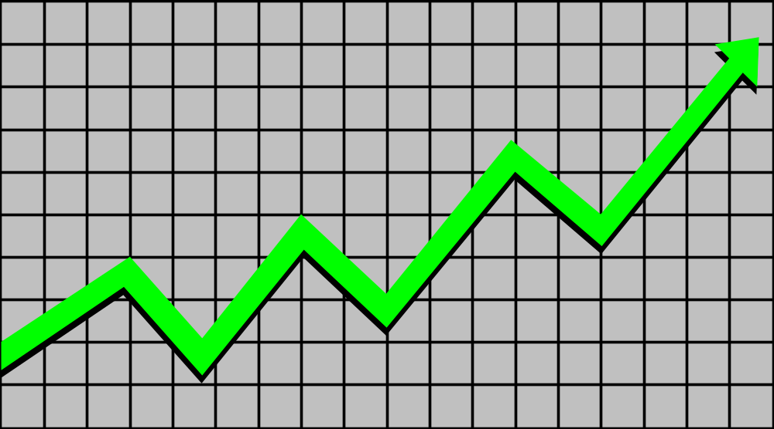
Goal of Acquisitions and Mergers
Increase size - easy!
Increase market value - much harder!

Slide 8
Goal: Market Value Addition
Definition
It is a measure of shareholder value creation
Methodology
It is the change in the market value of invested capital ( debt and equity) minus the change in the book value of invested capital

Slide 9
Value Changes In An Acquisition
10
Taxes on sale of assets
40
Profit on sale
of assets
Synergies and/
or operating
improvements
Value of
acquired
company as
a separate
entity
Value of
acquiring
company
without
acquisition
30
Takeover premium
50
50
Gain in
shareholder
value
75
250
175
Initial value
plus gains
Final value of
combined company

Slide 10
Goals of Acquisitions
Rationale: Firm A should merge with Firm B if
[Value of AB > Value of A + Value of B + Cost of transaction]
Synergy
Gain market power
Discipline
Taxes
Financing

Slide 11
Goals of Acquisitions
Rationale: Firm A should merge with Firm B if
[Value of AB > Value of A + Value of B + Cost of transaction]
Synergy
  Eg Martell takeover by Seagrams to match name and inventory with marketing capabilities
Gain market power
  Eg Atlas merger with Varity. (Less important with open borders)
Discipline
  Eg Telmex takeover by France Telecom & Southwestern Bell (Privatization)
  Eg RJR/Nabisco takeover by KKR (Hostile LBO)
Taxes
  Eg income smoothing, use accumulated tax losses, amortize goodwill
Financing
  Eg Korean groups acquire firms to give them better access to within-group financing than they might get in Korea's undeveloped capital market

Slide 12
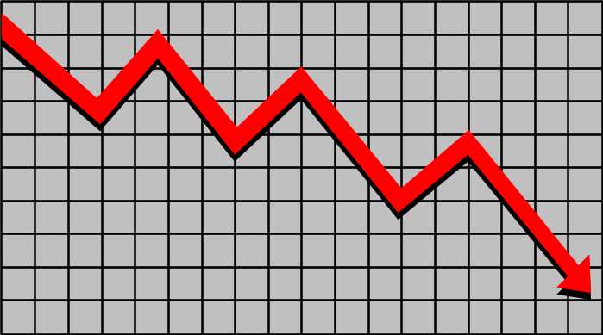
Fallacies of Acquisitions
Size (shareholders would rather have their money back, eg Credit Lyonnais)
Downstream/upstream integration (internal transfer at nonmarket prices, eg Dow/Conoco, Aramco/Texaco)
Diversification into unrelated industries (Kodak/Sterling Drug)

Slide 13
Methods of Acquiring Corporate Control
Mergers
  Bidder typically negotiates a friendly agreement with target management and submits this for approval to both sets of shareholders
  Usually entails an exchange of securities
Tender Offers
  Often hostile, often opposed, often generates competing bids
  Usually a direct cash offer to stockholders of an above-market price
Proxy Fights
  A method of gaining control without acquisition: dissident shareholders seek to change management by soliciting proxies from other shareholders.

Slide 14
Who Gains What?
Target firm shareholders?
Bidding firm shareholders?
Lawyers and bankers?
Are there overall gains?
Changes in corporate control increase the combined market value of assets of the bidding and target firms. The average is a 10.5% increase in total value.

Slide 15
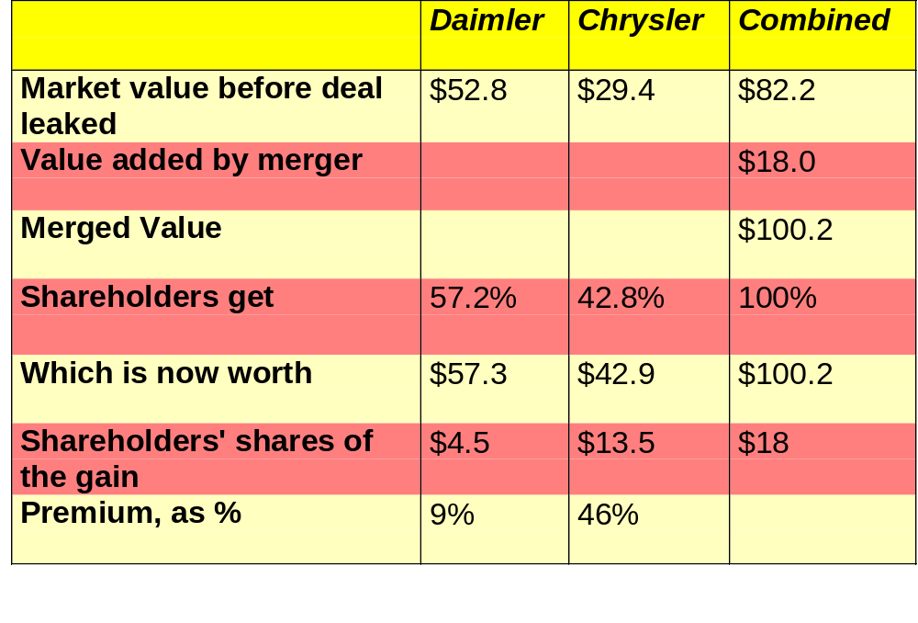
The Price: Who Gets What?

Slide 16
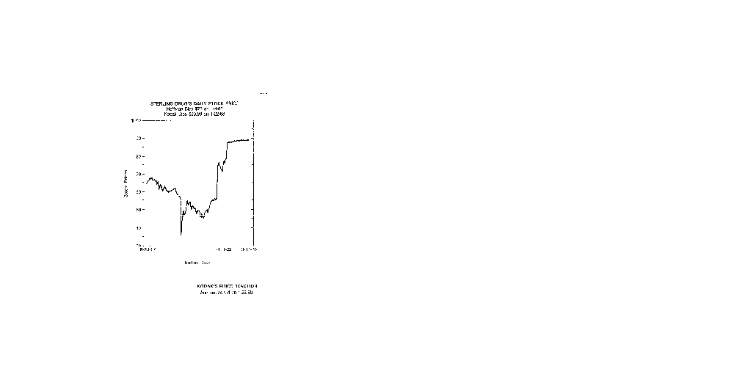
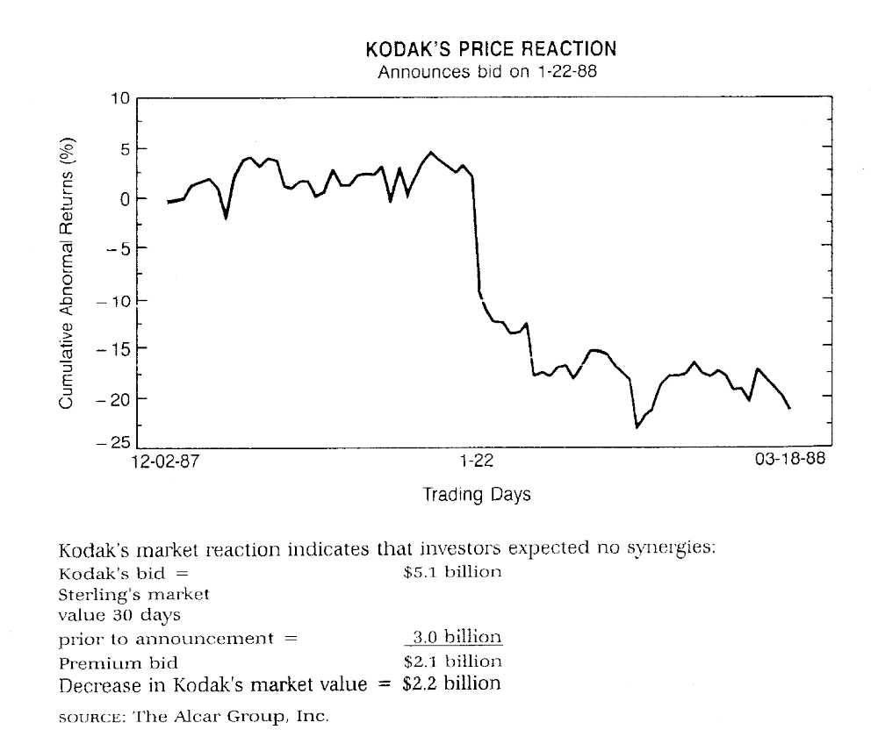
A Case Study: Kodak - Sterling Drugs
Eastman Kodak’s Great Victory

Slide 17
Earnings and Revenues at Sterling Drugs
Sterling Drug under Eastman Kodak: Where is the synergy?
5,000
4,500
4,000
3,500
3,000
2,500
2,000
1,500
1,000
500
0
1988
1989
1990
1991
1992
Revenue
Operating Earnings

Slide 18
Kodak Says Drug Unit Is Not for Sale (NYTimes, 8/93)
Eastman Kodak officials say they have no plans to sell Kodak’s Sterling Winthrop drug unit.
Louis Mattis, Chairman of Sterling Winthrop, dismissed the rumors as “massive speculation, which flies in the face of the stated intent of Kodak that it is committed to be in the health business.”

Slide 19
Sanofi to Get Part of Kodak Drug Unit (6/94)
Taking a long stride on its way out of the drug business, Eastman Kodak said yesterday that the Sanofi Group, a French pharmaceutical company, had agreed to buy the prescription drug business of Sterling Winthrop, a Kodak subsidiary, for $1.68 billion.
  Shares of Eastman Kodak rose 75 cents yesterday, closing at $47.50 on the New York Stock Exchange.
  Samuel D. Isaly an analyst , said the announcement was “very good for Sanofi and very good for Kodak.”
  “When the divestitures are complete, Kodak will be entirely focused on imaging,” said George M. C. Fisher, the company's chairman and chief executive.

Slide 20
Smithkline to Buy Kodak’s Drug
Business for $2.9 Billion
Smithkline Beecham agreed to buy Eastman Kodak’s Sterling Winthrop Inc. for $2.9 billion.
For Kodak, the sale almost completes a restructuring intended to refocus the company on its photography business.
Kodak’s stock price rose $1.25 to $50.625, the highest price since December.

Slide 21
Reasons Why Many Acquisitions Fail To Generate Value
Value
Destruction
Deal price not based on cash flow value

Slide 22
Reasons Why Many Acquisitions Fail To Generate Value
Over
optimistic
market
assessments
Value
Destruction
Deal price not based on cash flow value

Slide 23
Reasons Why Many Acquisitions Fail To Generate Value
Overestimating
synergies
Over
optimistic
market
assessments
Value
Destruction
Deal price not based on cash flow value

Slide 24
Reasons Why Many Acquisitions Fail To Generate Value
Overestimating
synergies
Over
optimistic
market
assessments
Value
Destruction
Poor
post-merger
integration
Deal price not based on cash flow value

Slide 25
Typical Losing Pattern For Mergers
Candidates are screenedon basis of industry and company growth and returns
One or two candidates are rejected in basis of objective DCF analysis
Frustration sets in; pressures build to do a deal; DCF analysis is tainted by unrealistic expectations of synergies
Deal is consummated at large premium
Postacquisitions experience reveals expected synergies are illusory
Company’s returns are reduced and stock price falls

Slide 26
To Succeed,
Analyse the Industry Structure
SUBSTITUTES
SUPPLIERS
CUSTOMERS
COMPETITIVE
ADVANTAGE
BARRIERS TO ENTRY

Slide 27
Using Industry Structure Analysis
SUBSTITUTES
Questions:
Do substitutes exist?
What is their price/
performance?
Potential Action:
Fund venture capital and
joint venture to obtain
key skills
Acquire position in new
segment
SUPPLIERS
Questions:
Is supplier industry
concentrating?
Is supplier value/cost
added to end product high,
changing?
Potential Actions:
Backward - integrate
CUSTOMERS
Questions:
Is the customer base
concentrating?
Is value added to
customer end product
high,changing?
Potential Actions:
Create differentiated
product
Forward - integrate
COMPETITIVE
ADVANTAGE
BARRIERS TO ENTRY
Questions:
Do barriers to entry exist?
How large are the barriers?
Are they sustainable?
Potential Actions:
Acquire to achieve scale in
final product or critical
component
Lock up supply of critical
industry input

Slide 28
Goals of Acquisitions
Rationale: Firm A should merge with Firm B if
[Value of AB > Value of A + Value of B + Cost of transaction]
Synergy
Gain market power
Discipline
Taxes
Financing
Example:
Ciba-Geigy/
Sandoz

Slide 29
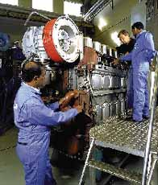

Most Value is Created on the Asset Side (Operational Restructuring)
Discounted Cash Flow (DCF) analysis for project evaluation
Value-Based Management for performance evaluation
Wärtsilä NSD
(from Wärtsilä Diesel & New Sulzer Diesel
?

Slide 30
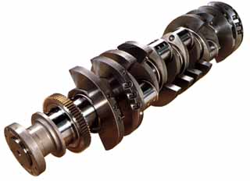
Wärtsilä NSD: Consolidating Production and Distribution
Wärtsilä NSD now has the world’s most extensive portfolio of heavy duty engines. Its 4-stroke engines are mainly Wärtsilä design, while the 2-stroke engines are based on Sulzer design. The engine range consists of lean burn gas engines, dual fuel engines and gas diesels. Market share is strong and production is being consolidated or out-sourced, particularly for low-speed engine technologies.

Slide 31
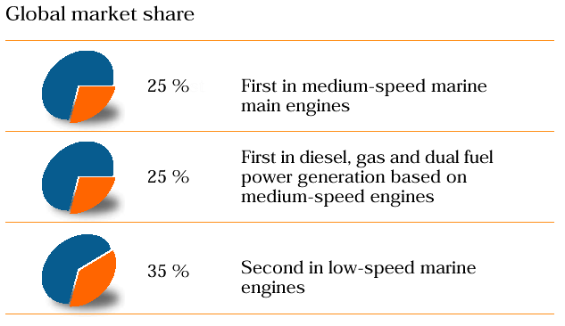
Wärtsilä NSD: Gains Market Power

Slide 32
Peruvian Banks: Market Share by Deposits, %
Sometimes, Too Late is Too Little
30
25
BBV ACQUISITION
20
15
SANTANDER ACQUISITION
10
5
0
Banco de la
Nacion
Santander
Credito
Continental
Interbanc
Latino
Del Sur
Lima
Nuevo
Mundo
Wiese

Slide 33
Corporate Restructuring
Divestiture—a reverse acquisition—is evidence that "bigger is not necessarily better"
Going private—the reverse of an IPO (initial public offering)—contradicts the view that publicly held corporations are the most efficient vehicles to organize investment.

Slide 34
Divestitures
Divestiture: the sale of a segment of a company to a third party
Spin-offs—a pro-rata distribution by a company of all its shares in a subsidiary to all its own shareholders
Equity carve-outs—some of a subsidiary' shares are offered for sale to the general public
Split-offs—some, but not all, parent-company shareholders receive the subsidiary's shares in return for which they must relinquish their shares in the parent company
Split-ups—all of the parent company's subsidiaries are spun off and the parent company ceases to exist.

Slide 35
Divestitures Add Value
Shareholders of the selling firm seem to gain, depending on the fraction sold:
Total value created by divestititures between 1981 and 1986 = $27.6 billion.
% of firm sold
Announcement effect
0-10%
0
10-50%
+2.5%
50%+
+8%

Slide 36
Gains from Breakup?
Intraco
Natsteel

Slide 37
Going Private
A public corporation is transformed into a privately held firm
The entire equity in the corporation is purchased by management, or managment plus a small group of investors
These account for about 20% of public takeover activity in recent years in the United States.
Can be done in several ways:
  "Squeeze-out"—controlling shareholders of the firm buy up the stockholding of the minority public shareholders
  Management Buy-Out—management buys out a division or subsidiary, or even the entire company, from the public shareholders
  Leveraged Buy-Out (LBO)

Slide 38
Leveraged Buy-Outs
LBO is a transaction in which an investor group acquires a company by taking on an extraordinary amount of debt, with plans to repay the debt with funds generated from the company or with revenue earned by selling off the newly acquired company's assets
Leveraged buy-out seeks to force realization of the firm’ potential value by taking control (also done by proxy fights)
Leveraging-up the purchase of the company is a "temporary" structure pending realization of the value
Leveraging method of financing the purchase permits "democracy" in purchase of ownership and control--you don't have to be a billionaire to do it; management can buy their company.

Slide 39
LBOs, Agency Costs and Free Cash Flow
"Free cash flow" is cash-cow type earnings in excess of amounts required to fund all positive-NPV projects
Payout of free cash flow, to stockholders, reduces the amount of resources under managment's discretion. Forces management to go out into the markets and justify raising funds
Thus debt has a disciplining role. “Safe” managers choose less debt.

Slide 40
Example (June 1996)
AT&T sells AT&T Capital (equipment leasing division) for $2.2 billion
The division goes private
Financed by:
  Bank debt
  Asset securitization
  $900 million equity (85% GRS UK, 10% Babcock & Brown, 5% management)
Another major step in AT&T’s restructuring

Slide 41
The LBO of EMAS
EMAS is in the retailing and hire-purchasing business in Malaysia
An LBO was done in 1998 by financial investors
The management of the business have been retained by EMAS to continue to operate the businesses
EMAS’s assets include a strong local brand-name, and high-yielding accounts receivables with a low default rate

Slide 42
The Buyout
EMAS was incorporated to buy existing assets, liabilities and business at 10.5 times prospective PER i.e. equivalent to 2 times book value, subject to a minimum of $52m and a maximum of $63m
The leveraged buyout was financed primarily by bank borrowings ($10.25m equity and $42m senior debt). The loan was made by the Malaysian Bumi Bank at Libor + 2%.
The vendors have an option to subscribe up to 20% of EMAS’s issued shares prior to IPO at an 8% discount from IPO price

Slide 43
After the LBO
EMAS’s existing business is profitable. However, additional funds are required to finance its expansion plan and the penetration into new business
EMAS intends to reduce its senior debt to more acceptable levels with proceeds from IPO targeted for launch before end-2000
Meanwhile, where can EMAS get additional funding?
And how will the lender get paid back?

Slide 44
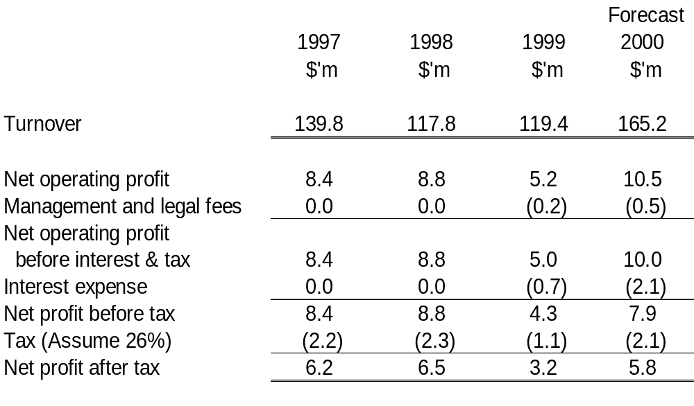
Income Statement

Slide 45
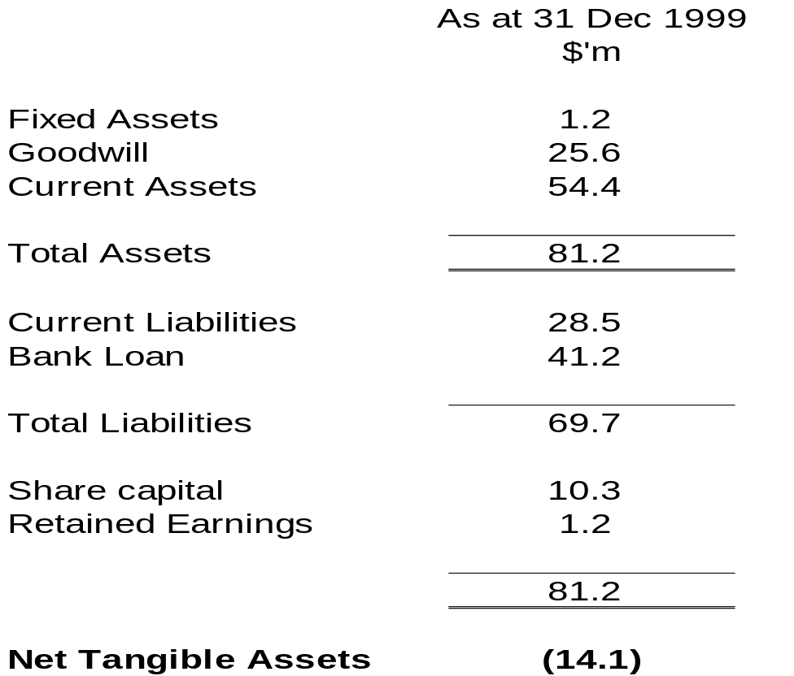
Balance Sheet

Slide 46
What's It Worth?
Valuation Methods
Book value approach
Market value approach
Ratios (like P/E ratio)
Break-up value
Cash flow value -- present value of future cash flows

Slide 47
How Much Should We Pay?
Applying the discounted cash flow approach, we need to know:
1. The incremental cash flows to be generated from the acquisition, adjusted for debt servicing and taxes
2. The rate at which to discount the cash flows (required rate of return)
3. The deadweight costs of making the acquisition (investment banks' fees, etc)

Slide 48
How Should We Pay?
Payment in cash
  (What happens to acquirer's stock price?)
Payment with debt
  (When you buy something by mail order, it's best to pay with a credit card)
Payment with equity shares
  (Figure out how many shares acquirer needs to offer)

Slide 49
Framework for Assessing Restructuring Opportunities
Current
Market
Current market
Value
Maximum
overpricing or
1
restructuring
underpricng
opportunity
Company’s
Total
DCF value
2
5
restructured
value
Restructuring
Financial
Framework
structure
Operating
improvements
improvements
(Eg Increase D/E)
3
4
Potential
Potential
value with
value with
internal
internal
Disposal/
+ external
improvements
Acquisition
improvements
opportunities

Slide 50
Using The Restructuring Framework
($ Millions of Value)
$1,000
Current
$ 25
Market
$ 635
Current
Price
Maximum
perceptions
1
restructuring
Gap: “Premium”
opportunity
Optimal
$ 1,635
$ 975
Company
2
5
restructured
value as is
value
Strategic
Restructuring
Financial
$ 300
and operating
Framework
engineering
$ 10
opportunities
opportunities
Eg Increase D/E
3
4
Potential
Potential
value with
value with
internal
internal
Disposal/
and external
improvements
Acquisition
improvements
opportunities
$ 1,275
$ 1,625
$ 350

Slide 51
Gains from Divestiture & Merger?
MPH
Popular

Slide 52
M&A Advisory Services:
1. Role of the Seller's Advisor
Develop list of buyers
Analyze how different buyers would evaluate company
Determine value of the company and advise seller on probable selling price range
Prepare descriptive materials showing strong points
Contact buyers
Control information process
Control bidding process
Advise on the structure of the transaction to give value to both sides
Ensure all nonfinancial terms are settled early
Smooth postagreement documentation

Slide 53
M&A Advisory Services:
2. Role of Buyer's Advisor
Thoroughly review target & subs
Advise on probable price range
Advise on target's receptiveness
Evaluate target's options and anticipate actions
Devise tactics
Consider rival buyers
Recommend financial structure and plan financing
Advise on initial approach and follow-up
Function as liason
Advise on the changing tactical situation
Arrange the purchase of shares through a tender offer
Help arrange long term financing and asset sales

Slide 54
M&A & D Opportunities
Target Companies
Need value chain integration – eg dependent on supplier – vertical integration
Benefit from greater efficiency – avoid cutthroat competition, achieve production or distribution efficiencies
Company has weak financials – flat earnings, overleveraged
Has several businesses that have no synergies – some growth, some flat
Company has businesses with incompatible cultures – or two different companies with compatible cultures
Company is in sector with overcapacity – too much bread (!) – benefit from consolidation
Company wants to buy competitor who could end up in a rival’s hands
Company wants to do an IPO but is not suitable – eg not in a “new economy” business, or the size is insufficient
Companies in the same line of business, but with P/E differentials
Conglomerate discount – company is undervalued in the market and would be worth more if some businesses were hived off
Owner wants to retire

Slide 55
Strategic Alliances:
An Alternative to Acquisition
"A strategic alliance is a collaborative agreement between two or more companies, which contribute resources to a common endeavor of potentially important competitive consequences, while maintaining their individuality."
Example with internal emphasis: Sunkyong with GTE, Vodaphone & Hutchinson Whampoa for cellular system
Example with external emphasis: Santander with Royal Bank of Scotland for European market in financial services
Driving forces:
  Complementary resources - gain strategic resources
  Similar capabilities - gain economies or market power

Slide 56
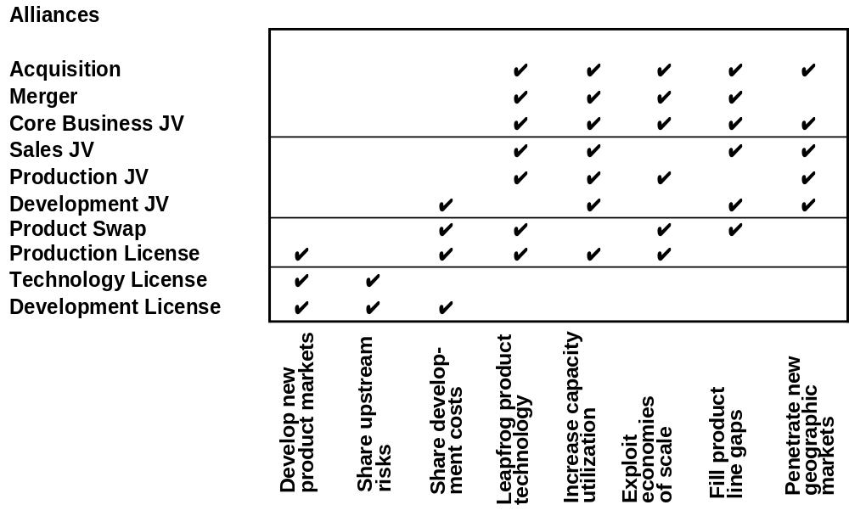
A List Of Alliance Options

Slide 57
Forms of Strategic Alliance
Many linkages are options for future development of relationships
POTENTIAL
FOR CONTROL
ACQUISITION
MERGER
WITH FULL
INTEGRATION
JOINT
VENTURE
JOINT
PROJECTS
SPECIFIC
DISTRIBUTION
OR SUPPLY
AGREEMENT
INFORMAL
ALLIANCE
IRREVERSIBILITY OF COMMITMENT

Slide 58
Questions to Ask Before the Alliance
Identify value creation logic to both firms. Are the logics similar? Are they compatible?
What is the potential value of the alliance to each firm (versus the cost of not having the alliance?)
What are the specific financial and competitive risks to each partner?
What is the value of complementary assets? Of common assets contributed?
Evaluate the investment each partner would make.
Evaluate other resource commitments.
What are the scope and boundaries of the alliance?
What commitments are made in the alliance?
What are the criteria for success? Are they shared?
What revenues and returns are projected? What risks?
What are the critical limiting factors?
Is there an action plan to reduce the limiting factors?

Slide 59
Mergers and Acquisitions: Summary
Mergers & Acquisitions
Divestitures
Valuation
Concept: Is a business worth more within our company, or outside it?

Slide 61
www.giddy.org

Slide 63
www.giddy.org
Ian Giddy
NYU Stern School of Business
Tel 212-998-0332; Fax 212-995-4233
ian.giddy@nyu.edu
http://www.giddy.org

